Slide 1
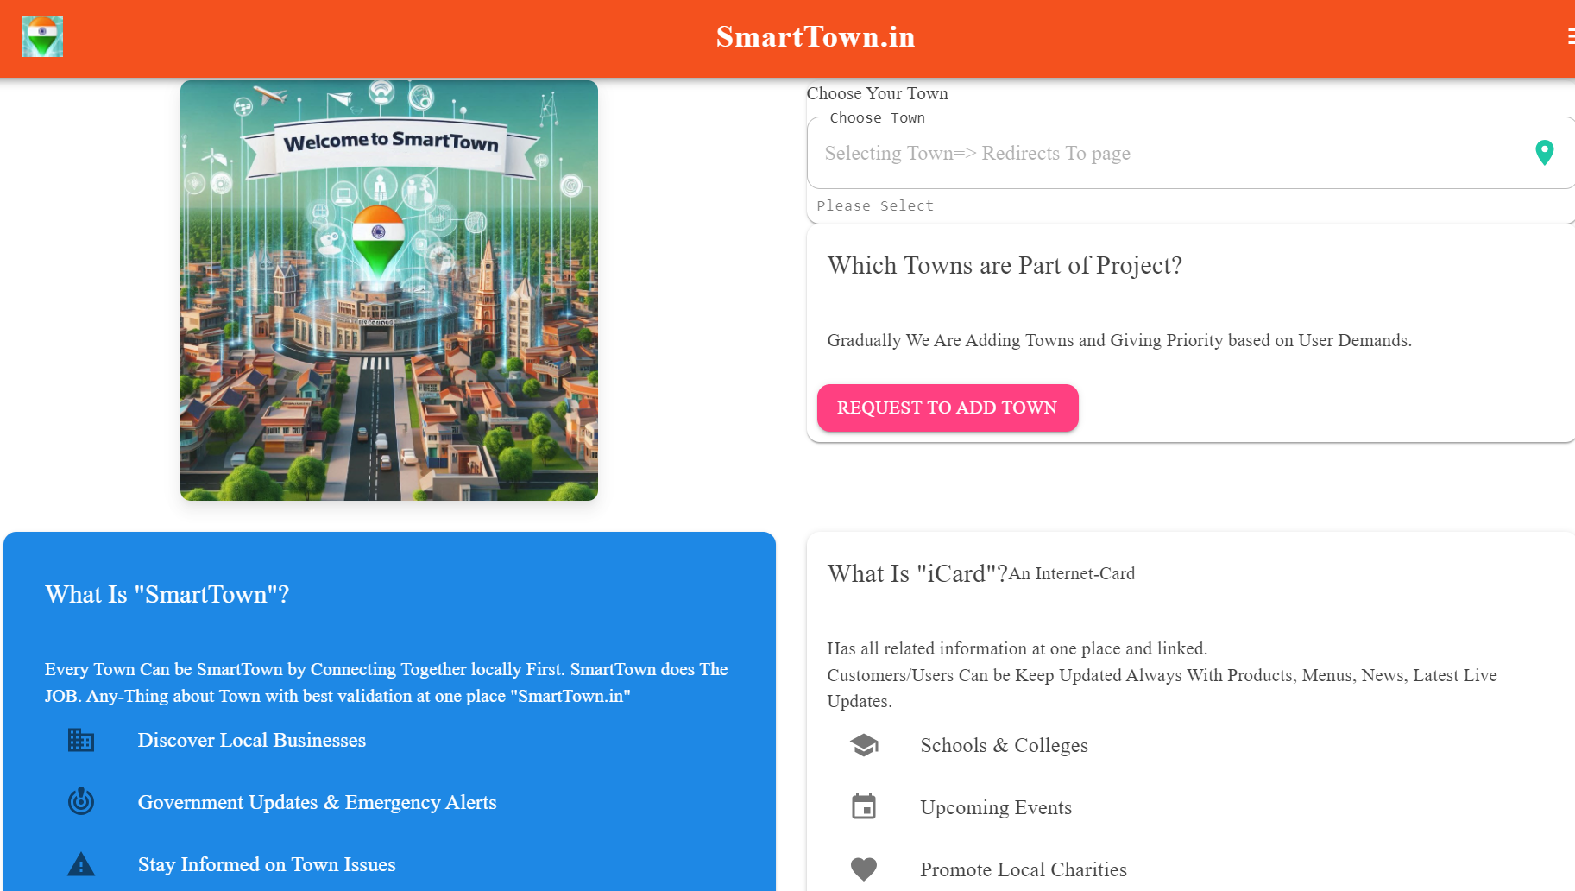

Slide 2


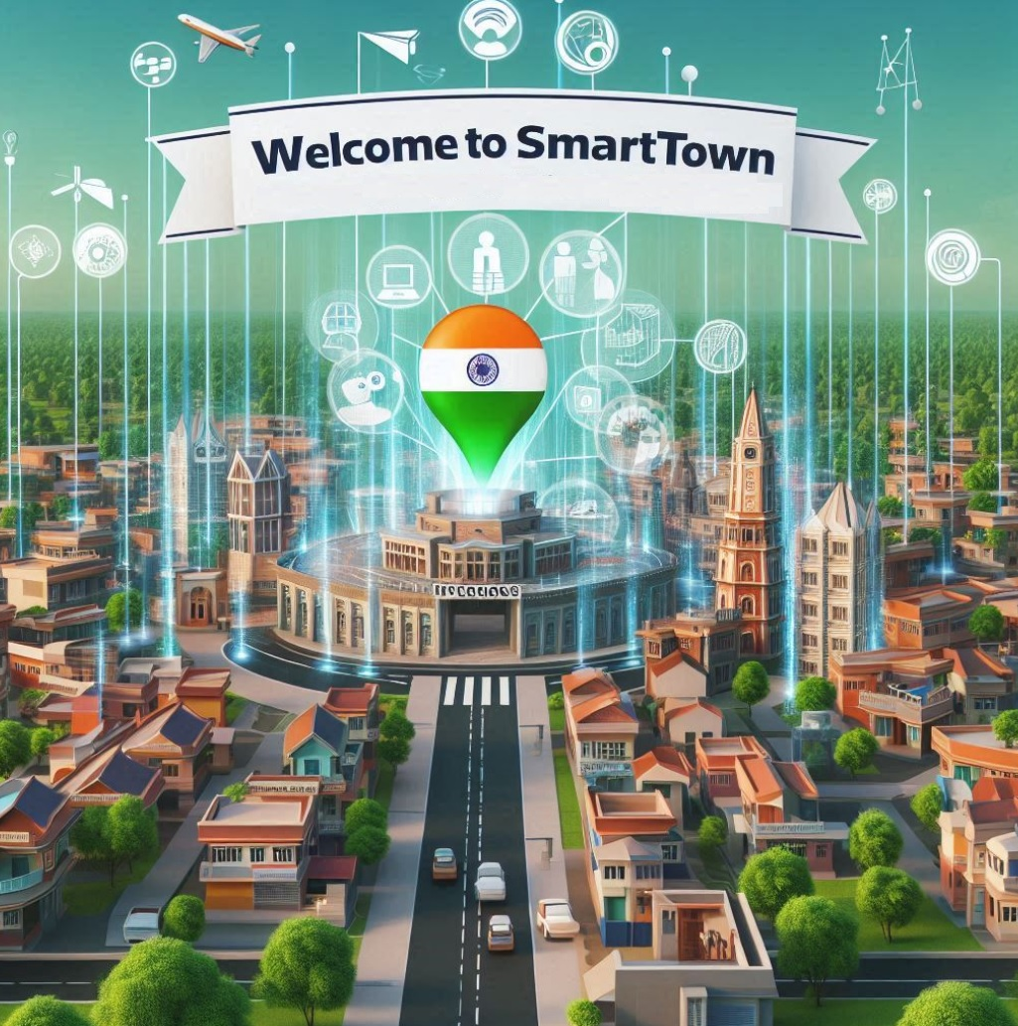
Katthe Technologies
Empowering ‘Local’ Talents Communities, & Resources

Slide 3

A Focused Approach
1
Transparent & Corrective Systems
2
Proper Utilization of Resources
Leveraging technology to create systems that are open, accountable, and responsive to community needs.
Ensuring that existing resources are used effectively and efficiently to benefit the community.
3
Direct Contribution to the Needy
Connecting those in need with resources and opportunities through innovative platforms.

Slide 4
Our Innovative Projects
SmartTown.in
Hennu.in
UnWell.in
A centralized, town-based platform that enables easy, self-controllable access to local businesses, services, and community information.
A dedicated platform focused on girl and women's safety and empowerment, leveraging technology to create a safer environment.
Making health and medicines more affordable and accessible for everyone, with a non-commercial approach.

Slide 5

Our Office & Team
Our registered office is located in the vibrant city of Bhadravathi, Karnataka, India.
Mostly all remotely connected, based on need will make more offices across the globe.
Madhusudhan V
Architect, with extensive experience in international key projects and a passion for community-driven solutions.
Global Contributors
Namitha K
Manjushree V Veerabhadrappa R … more adding Gradually
We connect with a network of global contributors and freelancers to bring diverse perspectives and expertise to our projects.
Non-Technical Contributions
We welcome contributions from a wide range of individuals, including housewives, handicaps, retired experts, students, and government employees.

Slide 6
School, College
Doctor, Hospital
Real Estate Buy or Sale
Hotel or Lodging
Emergency info
Bank, Government News
Town updates
Sports, Events
Lost or Found
Jobs , Open/Seeking

Slide 7
Problems..(In My Town?)
>which all orthopedic doctors available & what time
>School/college how to share news like Admissions open, tomorrow
>Government, Political Events and News
>Small Gifts shop cant advertise over fb/google as non affordable . How to advertise

Slide 8

Solution: SmartTown
Instead of 15-20$ /day => 1$/day
Pay as much as you use
Centralized, Sand-Boxed & Authenticated
Continuation with existing Fb,Youtube,Google business, Oyo or any local and continuation
Easy & Live updates
No Hidden or Fake... Complete Transparent pricing
No Advertisement… Always Clean & only needed
Simple dedicated & Easily Manageable software
Peer Validation & Administration Eye Always
AI-Analysis using AI of Enquiry, feedbacks ,Tracking l

Slide 9

Addressing the Information Gap
1
Missing Information
2
Lack of Connectivity
Residents often struggle to find reliable, up-to-date information about local businesses, services, and events.
Small businesses have limited options to effectively reach and connect with their local customer base.
3
Decentralized Data
Information is scattered across multiple platforms, making it difficult for both residents and businesses to access.

Slide 10
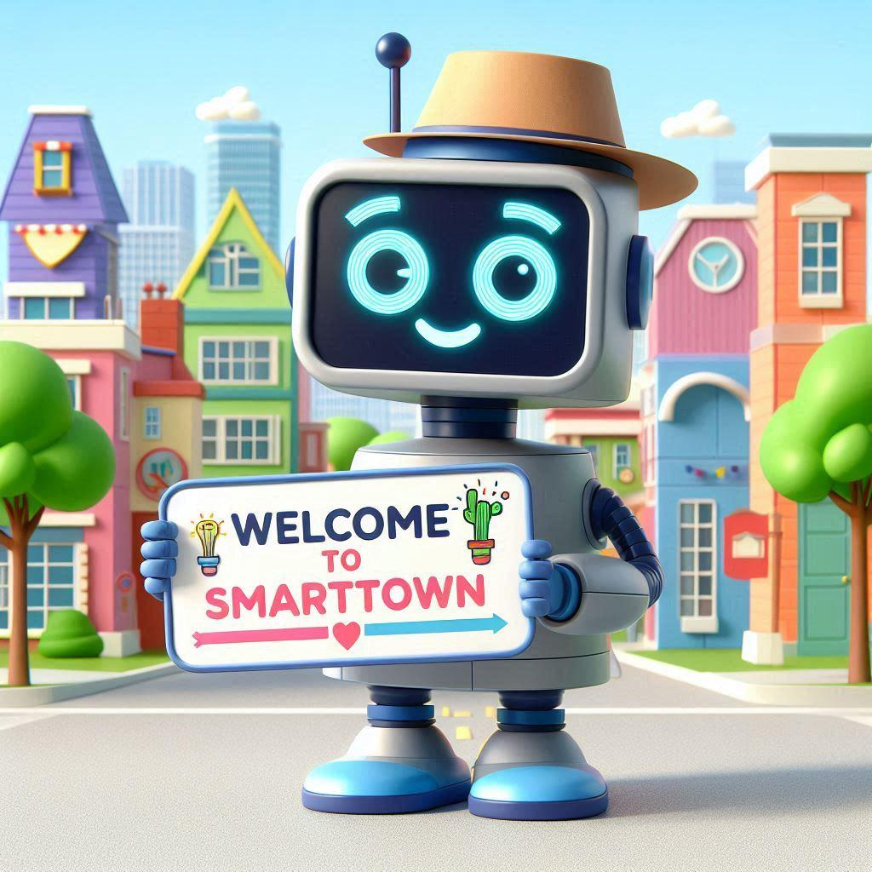
SmartTown: Your Town's Digital Hub
Centralized Data
Empowering Businesses
Informed Residents
SmartTown aggregates and organizes all the essential information about your town in one user-friendly platform.
Local businesses can easily create and manage their online profiles, share updates, and connect with customers.
Residents can access real-time information about businesses, events, and community news with just a few taps.

Slide 11
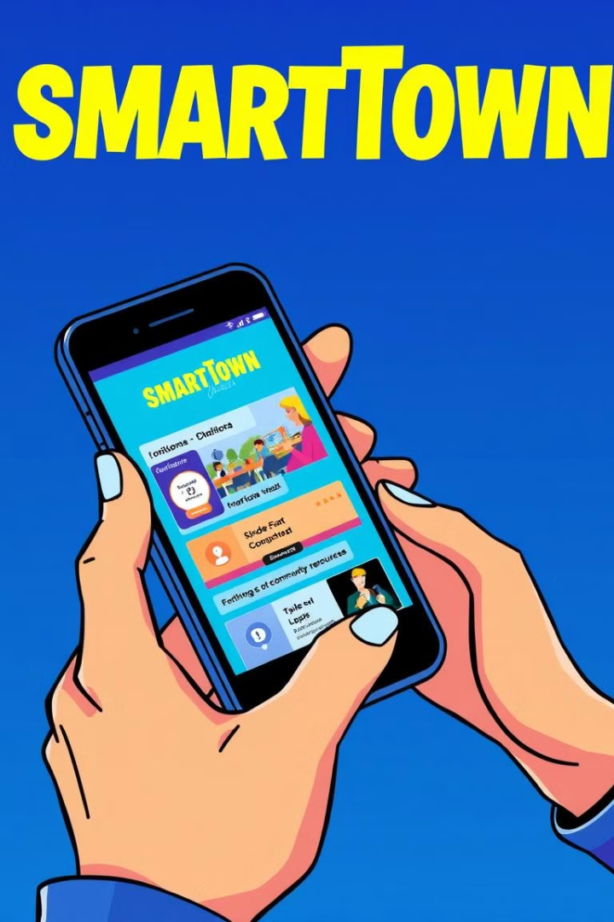
Simplifying Local Interactions
Easy Access & Live
Transparent Pricing
User-friendly and accessible, with a mobile-friendly interface and offline capabilities.
Flexible and affordable advertising options for local businesses, with no hidden fees or commissions.
Peer Validation
Customizable Profiles
Business listings are verified by the community, ensuring accurate and reliable information for users.
Businesses can easily update their profiles, menus, and offerings, keeping their information current and engaging.

Slide 12





Connecting Businesses and Customers
Business Profiles
Events & Promotions
Customer Reviews
Direct Communication
Businesses can create detailed profiles to showcase their offerings, hours, and contact information.
Businesses can easily share their upcoming events, sales, and special offers with the local community.
Customers can leave reviews and ratings to help others make informed decisions about local businesses.
Customers can directly contact businesses through the platform, fostering better customer-business relationships.

Slide 13
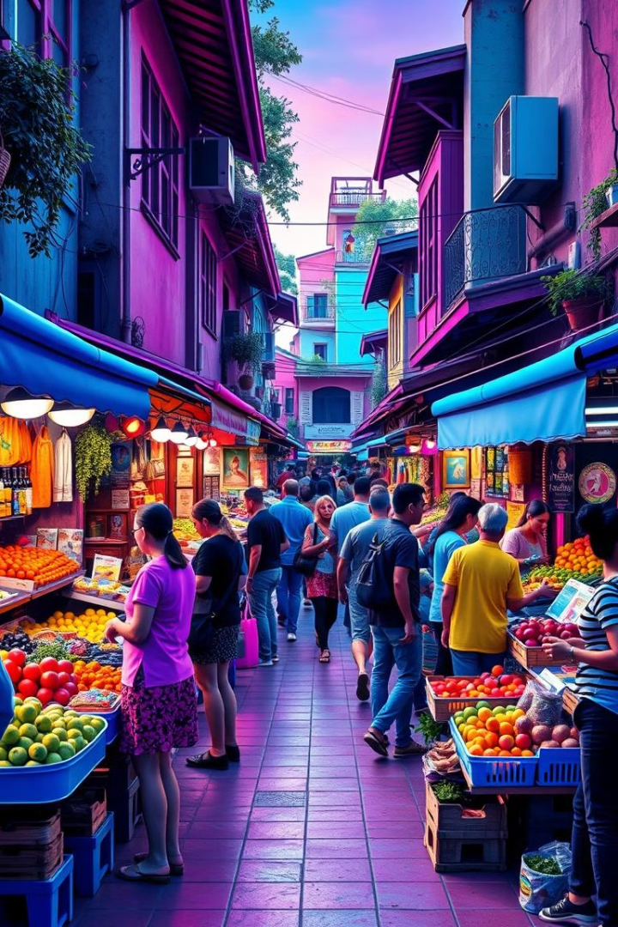
Empowering Local Economies
1
Increased Visibility
SmartTown helps local businesses reach a wider audience and gain more visibility within their community.
2
Fostering Connections
The platform facilitates connections between businesses and customers, leading to more engaged local communities.
3
Supporting Growth
By providing affordable and effective marketing tools, SmartTown enables small businesses to thrive and expand.

Slide 14
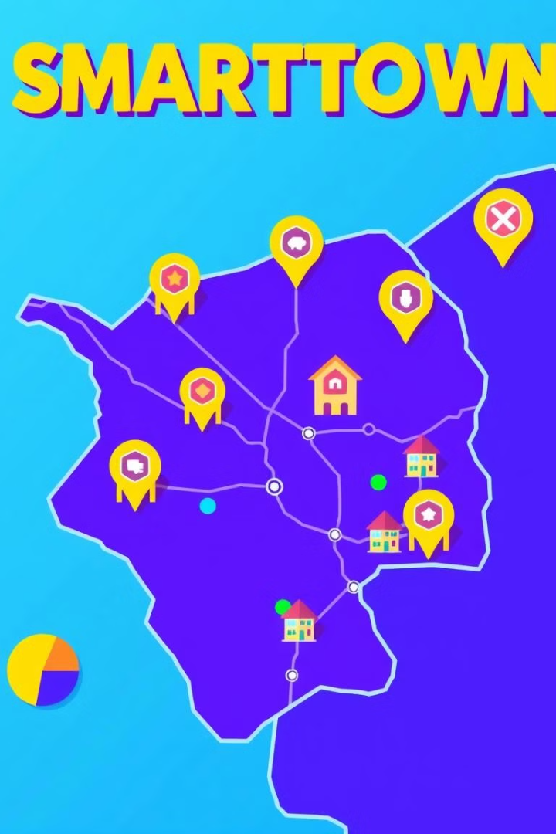



Expanding Reach, One Town at a Time
Scalable Model
SmartTown's modular design allows for easy replication and deployment in new towns, creating a network of connected communities.
Customizable Branding
Each SmartTown instance can be tailored to the unique identity and needs of the local community, ensuring a seamless user experience.
Collaborative Growth
SmartTown encourages peer-to-peer validation and community engagement, fostering a shared sense of ownership and pride.

Slide 15

Your Town, Your Voice
Resident Feedback
Streamlined Communication
Collaborative Decision-Making
SmartTown provides an easy platform for residents to share their ideas, concerns, and feedback about their town.
The platform facilitates transparent and efficient communication between local authorities, businesses, and the community.
SmartTown empowers residents to actively participate in shaping the future of their town through collaborative initiatives and decision-making processes.

Slide 16

Join the SmartTown Revolution
1
Become a Partner
2
Spread the Word
3
Stay Involved
Collaborate with us to bring the power of SmartTown to your community and help shape the future of local connectivity.
Share the vision of SmartTown with your friends, neighbors, and local businesses, and help us build a network of thriving, connected towns.
Provide feedback, suggestions, and ideas to help us continuously improve the SmartTown platform and better serve the needs of your community.

Slide 17

The Future of Local Communities
SmartTown is not just a platform – it's a vision for the future of local communities. By empowering residents and businesses with the tools they need to connect, collaborate, and thrive, we're building a network of towns that are more transparent, engaged, and prosperous than ever before.

Slide 18





Connect with Us
Email
Katthe@Outlook.in
Katthe@Katthe.com
Company
www.Katthe.com
Product1
www.SmartTown.in
Phone
+91-9482696525

